Slide 1

Finance for IT managers
International Masters
Spring 2018 program
© Sylvie Appriou

Slide 2
Course description
The purpose of this Finance class is to help you, as IT managers, more effectively manage and control your work, budget and make better business decisions.
It should allow you to intelligently discuss with your Finance teams and effectively speak for the IT cause
This course provides an overview of basic financial concepts and their practical application to planning and budgeting an IT organization / IT projects.
As a student, you will gain knowledge and experience in Planning, Budgeting, Cost management and Project Value Case.

Slide 3
Learning objectives
A practical knowledge of business finance and financial decision-making through:
Review of Finance general principles
Planning and Budgeting / Cost Management
Introduction of planning concepts and components
Understanding of how to build an IT budget
Introduction of basic budget and cost management mechanisms
Preparation & evaluation of project value cases
Hands-on practice

Slide 4
Assessment method
Individual grade will be made up of:
20% Active class participation
80% Individual exam

Slide 5
Ground rules
Be respectful of those talking or presenting
Be ON TIME
Being late is a sign of disrespect to the trainer and your peers
After 10 minutes delay , you will not be accepted in class
Switch off your cell phones
Laptops or tablets are tolerated only for in-class case case studies
Do not be shy, participate actively and ask clarification questions as you see fit
One discussion at a time, please!

Slide 6
Expectations & policies
I expect you to turn-in your completed assignments on time to receive proper credit/grade
Any work submitted must be your own
I expect everyone to contribute equally to group assignments (if any)
Attendance in every class is expected, active class participation and discussion is strongly encouraged
Late work submission will not be accepted unless prior arrangements have been made directly with me
Cases will be decided on an individual basis

Slide 7
Sessions calendar
Session nb | Date | Time | Contents
1 | Thursday July 12th | 10:00– 13:00 | Introduction
2 | Wednesday July 18th | 10:00 – 13:00 | Home work review + class
3 | Wednesday July 25th | 10:00 – 13:00 | Home work review + class
4 | Wednesday July 25th | 15:00 – 17:00 | Exam

Slide 8
Course schedule and contents
Session 1
Introduction
Corporate Finance general concepts
Session 2
Planning and Budgeting, Cost Management
Case study
Session 3
Project value case
Case study

Slide 9
Introduction

Slide 10
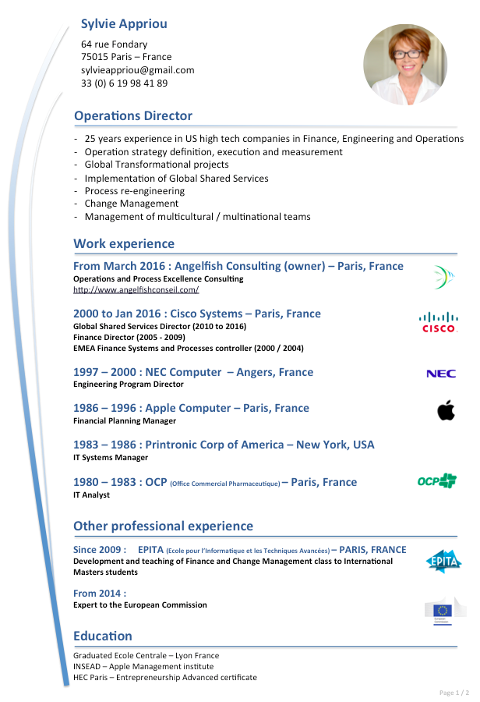
Welcome to my class…
Nice to meet you…
Brief personal introduction…
What this class is and isn’t…

Slide 11
You and change management
Please, prepare a brief verbal introduction of yourself, highlighting:
Who you are, where you come from…
What EPITA curriculum you belong to…
Your work field experience (if any) prior to joining EPITA (i.e. Software develpt. for automotive industry)
Do you have any Finance knowledge / experience? In what context? What can you share with us?
Any particular expectation from the Finance class ?

Slide 12
Course schedule and contents
Session 1
Introduction
Corporate Finance general concepts
Session 2
Planning and Budgeting, Cost Management
Case study
Session 3
Project value case
Case study

Slide 13
Corporate Finance general concepts

Slide 14
Corporate Finance Key concepts
Balance Sheet
Income statement (P&L : Profit and Loss)
Profit vs Cash
Depreciation / Amortization
Critical Performance ratio
Finance quiz

Slide 15
Corporate Finance Key concepts
GL – General Ledger or journal
GAAP – Generally accepted Accounting principles
Chart of Account
Balance Sheet
- Assets : Cash, Fixed assets, Receivables
Liabilities : Payable, debts
Equity : capital, stock
Depreciation, amortization
Income Statement (P&L)
Income
COGS : Cost of Goods sold
Expenses
Working capital
Cash flow statements
Financial ratios (Current ratio, Inventory turns, DSO, P/E…)
Accruals vs Cash Accounting

Slide 16
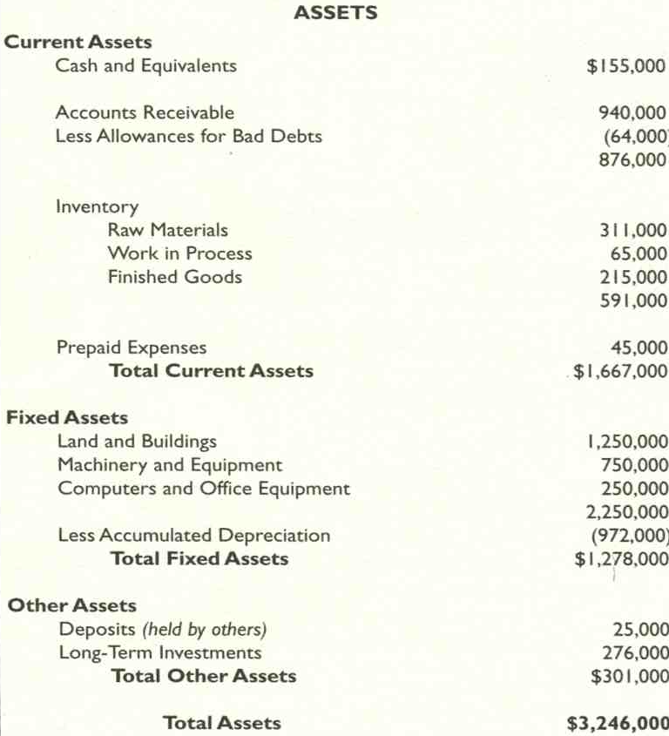
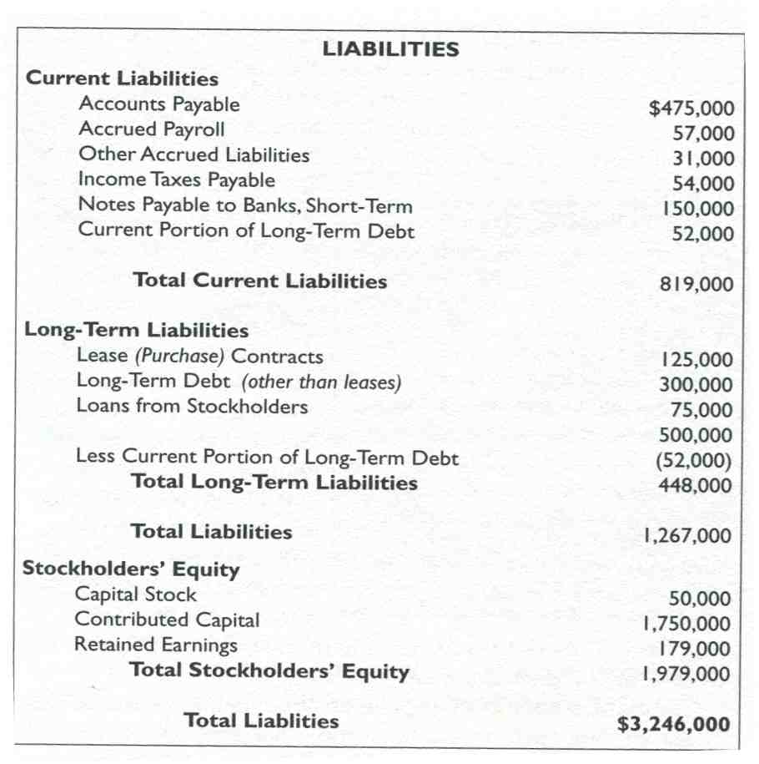
Balance Sheet

Slide 17
Balance Sheet
Working Capital
Current Assets – Current liabilities
Measurement of liquidity
Key drivers DSO (Days sales outstanding)
Account Payable as a source of Financing
Inventory management is critical!
- High risk area
Watch Account Receivable collectibility

Slide 18
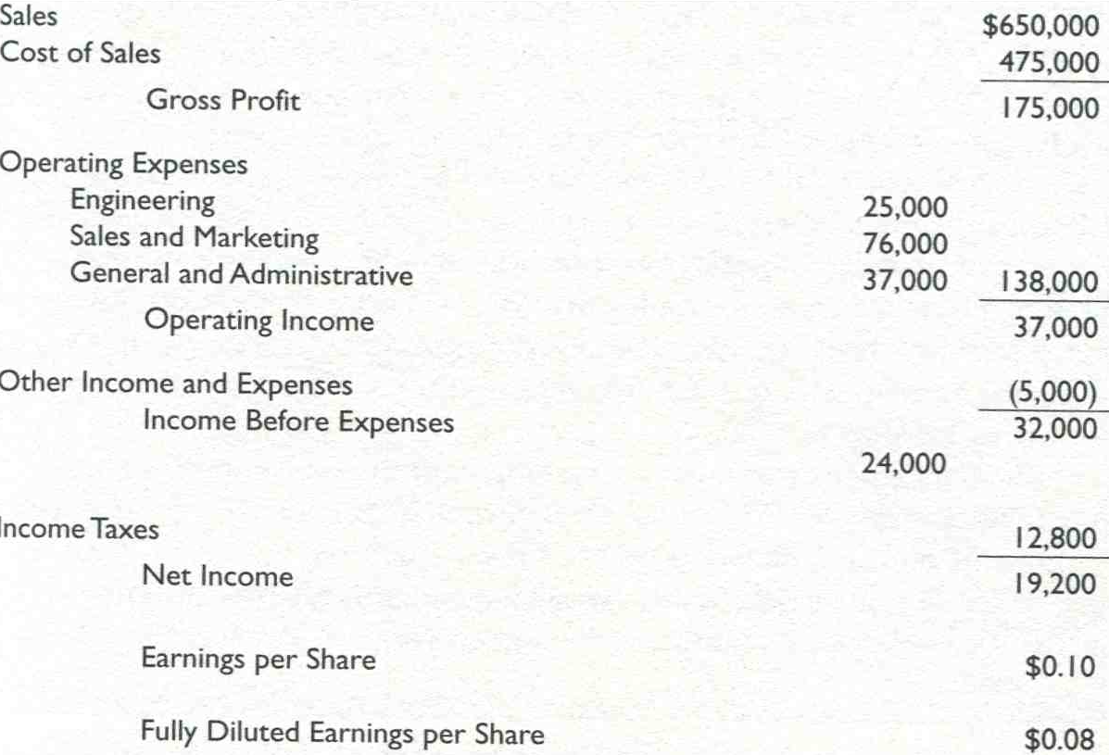
Income Statement (P&L)

Slide 19
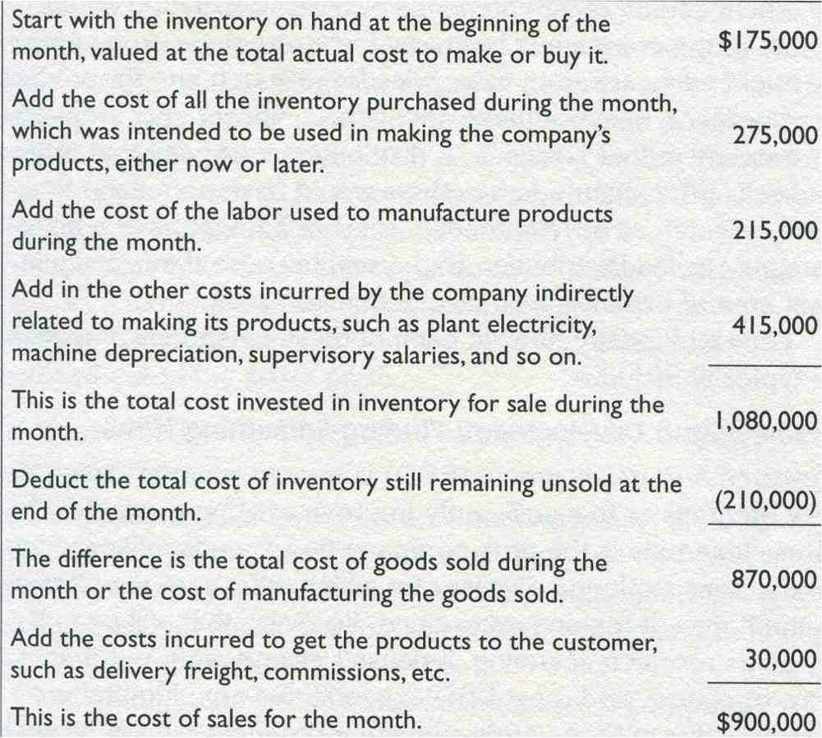
Income Statement (P&L) Cost of Sales

Slide 20
Income Statement (P&L)
Record Sales too early or too late…or record Sales that have not happened yet. Question of Revenue recognition
Gross profit as the 1st measurement of profitability
Operating expenses : running the business
R&D
Sales and Marketing, includes sales Commissions
G&A : Catch all category including IT
Operating income = Bottom line
Very strict rules of what to account in each category. Example of IBM selling a subsidiary and booking profit into G&A…

Slide 21
Balance Sheet vs P&L
Balance Sheet T1
Income Statement (P&L) for the period T1 – T2
Balance Sheet T2

Slide 22
Profit vs Cash
Accruals vs Cash accounting…
Cash accounting : transactions are recorded when cash is involved
Accruals accounting : transactions are recorded when they really happen even if payment is done later
Sales recorded when customer is invoiced
Purchase recorded when goods received

Slide 23
Wonder Widget story
Start up launched with 100,000$ in cash
Leased factory and equipment
Bought material
Hired workers
Very succesful product that sells very well
Making good profit
Sales keep increasing
- 50,000 k$ in Month 1 and increasing by 50,000$ every month
Normal business operations (clients pay on time, they pay suppliers…)
All going very well…

Slide 24
Wonder Widget story
One day, owners go to the bank and realize there is no money to pay the bills, make Payroll or buy raw materials
Finally, creditors took the company to court and nearly had the company closed down
Instantly profitable Wonder Widget was insolvent 6 months after they open the doors
What happened ?

Slide 25
Cash Flow cycle
Assets
Set up
Credit
Starting point
Cash
Ending point
Production
Collection
Sales

Slide 26
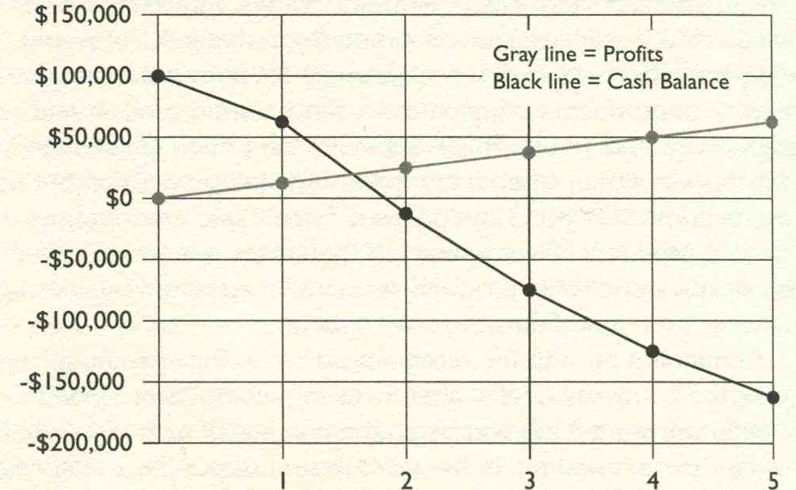
Cash Flow curve

Slide 27
Fast growth means big appetite for cash
Need to set up the company and production activities
Start production, shipping and billing customers
Need to pay suppliers, Need to collect from customers
…Timing is everything
Options
Raise price ?
Get receivable financing ?
Raise more capital ?
Cash is not profit : Need careful cash forecast

Slide 28
Net Profit vs Cash Flow
Transactions that increase profit but don’t produce cash until later : Sales / Account receivable
Transactions that reduce profit but don’t decrease cash until later : Account Payables
Transactions that put cash in the bank but don’t produce profit until later …if at all : Get a loan…
Transactions that take cash from the bank and may or not affect profit later : Repay loans, purchase assets (machinary…)

Slide 29
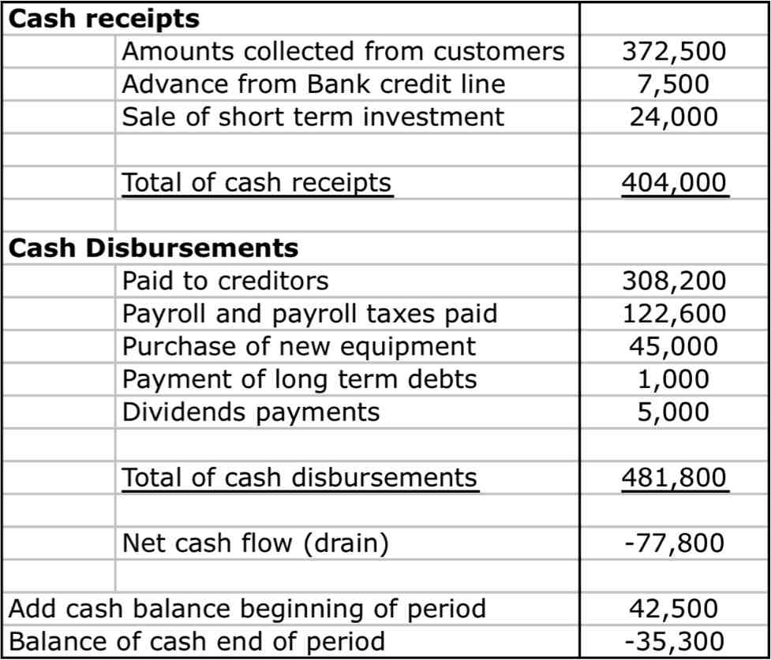
Cash Flow statement

Slide 30
Profit vs Cash Flow Summary
Cash flow statement is complementary of Income Statement / P&L
Cash is needed to finance customers purchases on credit
If Account receivable grow faster than sales, it is a cash drain for the company
It is the largest cash requirement for growing company
Inventory is a large consumer of cash
Cash invested in Inventory can take a long time to convert to cash again
If inventory grows quicker than sales, the company may be wasting its cash and take a risk of obsolescence

Slide 31
Depreciation / Amortization
Depreciation
Expense charged against earnings to write off the cost of a capital asset over time
Consider age, wear, residual value, obsolescance
Several methods of depreciating assets
Straightline
Accelerated
Amortization
Spreading the cost of intagible asset over the life of the asset
Ex : SW licence, R&D expenditure

Slide 32
Critical Performance ratio (CFP)
PE : Price to earning ratio
Stock price / Earnings per share
Guideline : under 20
Current ratio
Current assets / Current liabilities
Assessment of liquidity of a company
Guideline 2
Quick ratio
Variation on Current ratio
(Current Assets – Inventory) / Current liabilities
Guideline 1.3

Slide 33
Critical Performance ratio (CFP)
DSO – Days Sales Outstanding
Nb of days of average sales yet uncollected in Accounts Receivable
Account receivable / Average revenue / day
Ideally 30, in practice 45 days
Inventory turnover
Annual cost of good sold / Average Inventory
Measures how quickly inventory leaves the plant and is replaced by new inventory
Guideline > 7

Slide 34
Critical Performance ratio (CFP)
Gross profit margin
Gross profit / Gross sales
Good indicator of business model
Can go from 20 % to 80%...
Net profit margin
Net profit / Gross sales
Also, can vary a lot…3% would be very bad for SW, drug or manufacturing business but good for distribution business
Need to compare companies in same industry
Need to look at evolution over time

Slide 35
Critical Performance ratio (CFP)
Cost per Sales dollar
Sales and marketing costs / Gross Sales
G&A costs / Gross Sales
R&D costs / Gross Sales…
Need to look at evolution in time
Measures of productivity
Backlog of orders : Orders received – Orders shipped and invoiced
Order Processing time : indicator of customer satisfaction
Sales / employee
Sales / square foot

Slide 36
Critical Performance ratio (CFP) Summary
CFPs are key indicators of success of a business
Should be clarity of target value / budget
Comparison vs Budget and overtime is critical
Gross margin % goes down : need to understand why ?
Price down, too much discount ?
Costs up ?
Product mix ?
Competitive pressure ?
Should be compared to industry benchmark
Should be tracked over time and variations analyzed

Slide 37
Thank you!
See you next time

